Slide 1



DETECTION OF SEPSIS FROM PATIENT VITAL SIGNS
Team No. : 12
College : RMKCET
INTELLECTUAL CREW
© 2023 Cognizant

Slide 2
Team members name | Mail id | Team faculty mentors | Faculty mentor mail ID | Cognizant mentor name | Cognizant mentor mail ID
ALAPATI DEVI ANUSHA | alap20ad004@rmkcet.ac.in | Ms.A.Akila | aakilaads@rmkcet.ac.in | NITIN TEWARI SHIVAM SHRIVASTAVA | nitin.tewari@cognizant.com shivam.srivastava@cognizant.com
BATTEPATI DHARANI | batt20ad007@rmkcet.ac.in | Ms.A.Akila | aakilaads@rmkcet.ac.in | NITIN TEWARI SHIVAM SHRIVASTAVA | nitin.tewari@cognizant.com shivam.srivastava@cognizant.com
PUNURU DIVYA HARSHITHA | punu20ad038@rmkcet.ac.in | Ms.A.Akila | aakilaads@rmkcet.ac.in | NITIN TEWARI SHIVAM SHRIVASTAVA | nitin.tewari@cognizant.com shivam.srivastava@cognizant.com
VADLAMUDI LAKSHMI TEJASWINI | vadl20ad053@rmkcet.ac.in | Ms.A.Akila | aakilaads@rmkcet.ac.in | NITIN TEWARI SHIVAM SHRIVASTAVA | nitin.tewari@cognizant.com shivam.srivastava@cognizant.com
Team Name –INTELLECTUAL CREW
Team No – 12
RMKCET
2
© 2023 Cognizant

Slide 3

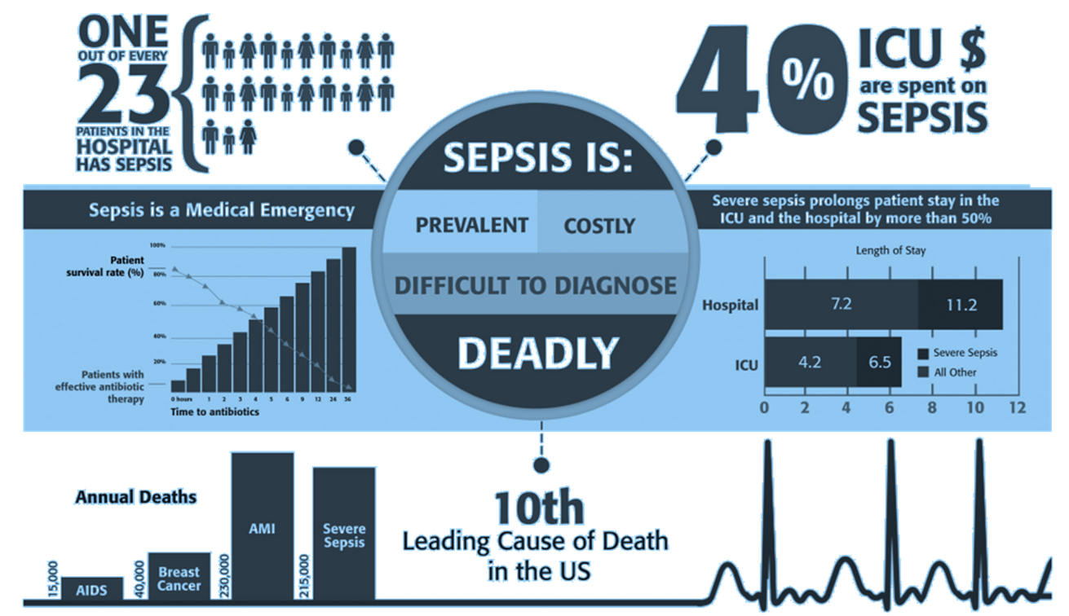
What is Sepsis ?
Sepsis is a severe medical condition.
It is caused by the body's overwhelming response to an infection.
The infection can be localized, such as in the lungs, urinary tract, or skin.
It can also be systemic, spreading throughout the body.
What is Sepsis ?
24/7
Sepsis involves widespread inflammation triggered by the body's immune response.
This inflammation leads to organ dysfunctions.
Symptoms include fever, increased heart rate, rapid breathing, and altered mental status.

Slide 4


3 STAGES OF SEPSIS ?
1.
Sepsis
Sepsis is defined as a life-threatening condition that arises when the body's response to an infection causes organ dysfunction.
II. Severe Sepsis
Severe sepsis occurs when there is sepsis along with evidence of organ dysfunction, hyperfusion (inadequate blood flow to organs and tissues), or an alteration in mental status. Organ dysfunction can manifest as abnormal laboratory values.
Severe sepsis
2.
3.
III. Septic Shock
Septic shock is the most severe stage of sepsis and is defined as sepsis with profound circulatory, cellular, and metabolic abnormalities. . Septic shock carries a higher risk of mortality compared to other stages of sepsis.

Slide 5

BUSSINESS OBJECTIVE
•Goal of the analysis is the early detection of sepsis using vital signs data.
•The early prediction of sepsis is potentially life-saving, and we aim to predict sepsis, before the occurrence of sepsis.
•We will be predicting the % chance of occurrence of sepsis in a person with the reasons stated using laboratory values, vital signs and patient information, in the website.

Slide 6







SOLUTION
DEPENDENCIES :
LIMITATION :
CONTENT FOR DETECTION
Kaggle
Python Library:
Pandas
Numpy
SKlearn
XGBoost
Vs Code
As individual responses to treatments may vary our model is only limited to predict using basic attributes.
1.Vital signs
2.Laboratory values
3.Patient Info

Slide 7









Python is used for writing the code and implementing the machine learning algorithms.
PYTHON
Excel
Data Cleaning
CSS is used for styling and formatting the web page to control its layout, design, and visual presentation.
TECH-STACK
CSS
JavaScript is used for adding interactivity and dynamic behavior to the web page
JAVA SCRIPT
HTML
HTML is used for defining the structure and content of the web page, providing the foundation for displaying text

Slide 8








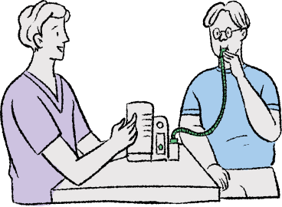


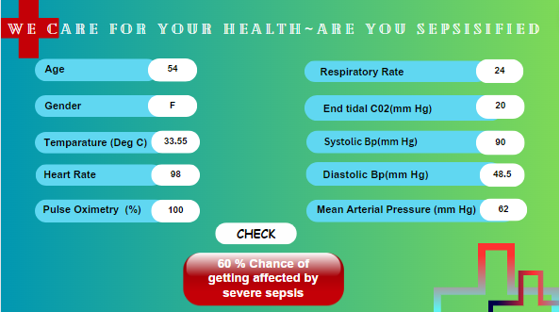
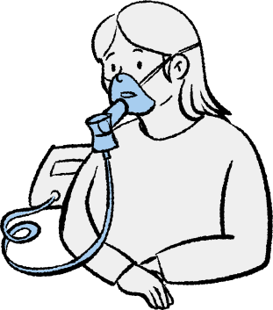


USE CASE
HEALTHY
SEPSIS

Slide 9

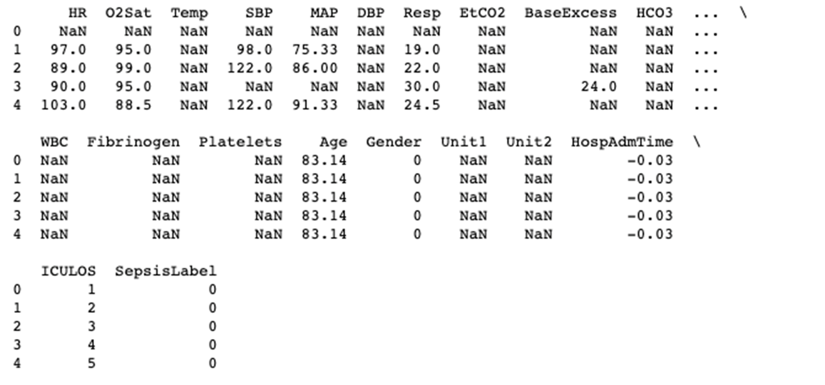
ATTRIBUTES INVOLVED
FEATURES :
8 VITAL SIGNS
26 LABORATORY VALUES
2 DEMOGRAPHICS
TARGET VALUE :
SEPSIS (1)
NO SEPSIS(0)

Slide 10

VITAL SIGNS (1 - 8 COLUMNS )
PATIENT INFO
Outcome (column 44)
HR Heart rate (beats per minute)
O2Sat Pulse oximetry (%)
Temp Temperature (Deg C)
SBP Systolic BP (mm Hg)
MAP Mean arterial pressure (mm Hg)
DBP Diastolic BP (mm Hg)
Resp Respiration rate (breaths per minute)
EtCO2 End tidal carbon dioxide (mm Hg)
SEPSIS (1)
NO SEPSIS(0)
Age
Years
Gender
Female (0) or Male (1)

Slide 11
Laboratory values (columns 9-34)
BaseExcess Measure of excess bicarbonate (mmol/L)
HCO3 Bicarbonate (mmol/L)
FiO2 Fraction of inspired oxygen (%)
pH N/A
PaCO2 Partial pressure of carbon dioxide from arterial blood (mm Hg)
SaO2 Oxygen saturation from arterial blood (%)
AST Aspartate transaminase (IU/L)
BUN Blood urea nitrogen (mg/dL)
Alkalinephos Alkaline phosphatase (IU/L)
Calcium (mg/dL)
Chloride (mmol/L)
Creatinine (mg/dL)
Bilirubin_direct Bilirubin direct (mg/dL)
Glucose Serum glucose (mg/dL)
Lactate Lactic acid (mg/dL)
Magnesium (mmol/dL)
Phosphate (mg/dL)
Potassium (mmol/L)
Bilirubin_total Total bilirubin (mg/dL)
TroponinI Troponin I (ng/mL)
Hct Hematocrit (%)
Hgb Hemoglobin (g/dL)
PTT partial thromboplastin time (seconds)
WBC Leukocyte count (count10^3/µL) Fibrinogen (mg/dL) Platelets (count10^3/µL)

Slide 12
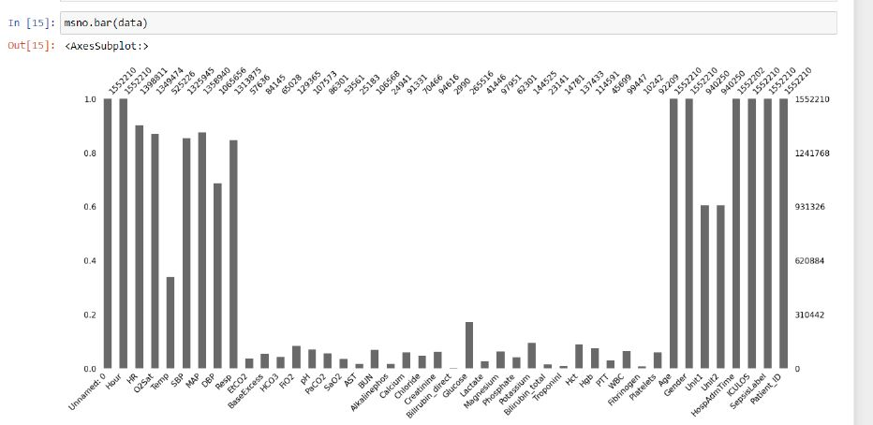
EDA - HANDLING MISSING VALUES
#1
The sepsis data collected has many missing values in it. There is more than 90% missing values in the dataset.
Two steps to handle:
Remove features with missing values > 92%
Categorically encode features to handle missing values
#2

Slide 13
After Dropping features with missing values more than 92%
#1
Vital Signs :
HR (beats/min) - Heart Rate higher than 90 beats per minute
Oxygen Saturation (%) - Pulse oximetry
Temp (Deg C) - Temperature - Fever abover 101ºF (38ºC) or below 96.8ºF (36ºC)
SBP (mm Hg) - Systolic BP - Systolic Blood Pressure less than or equal to 100 mm of mercury
MAP (mm Hg) - Mean arterial pressure - persistent hypotension; MAP >65 mmHg.
DBP (mm Hg) - Diastolic BP
Resp (breaths per minute) - Respiration rate - Breathing rate higher than 20 breaths per min
FiO2 Fraction of inspired oxygen (%) - FiO2 ≥ 0.60
Glucose
Potassium (mmol/L)
Hct Hematocrit (%)
#2
Lab values :

Slide 14
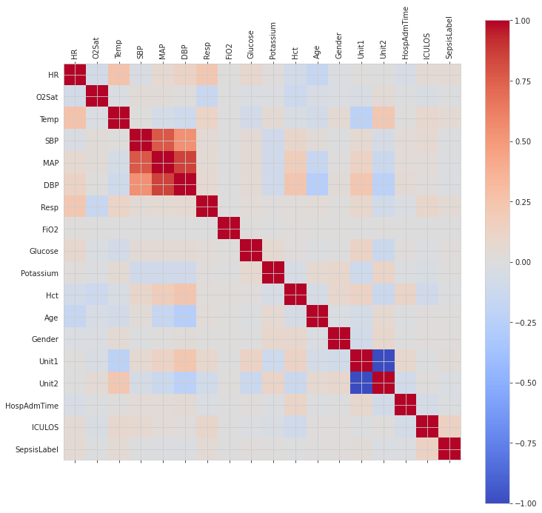
Correlation Matrix
After
Removing Missing Values
Removed missing values > 92%

Slide 15
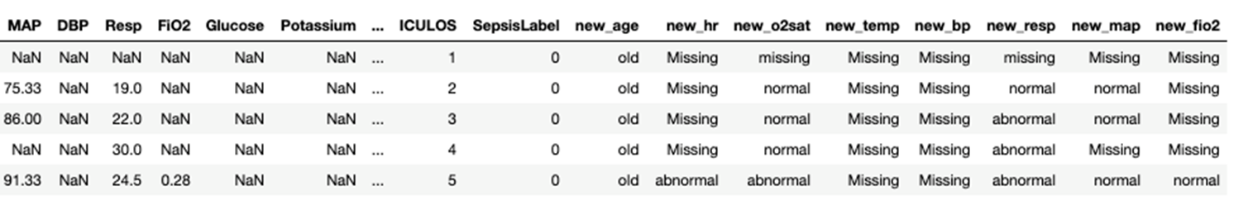
FEATURE ENGINEERING AND LABEL ENCODING
Developed 8 new features and are described :
new_age : has 3 categorical values – old, young and adult.
new_hr, new_temp, new_o2sat, new_bp, new_resp, new_map, new_fio2: Has 3 categorical values – normal, abnormal and missing Next, performed feature section again on them and selected all above features, plus Gender, Hospital Admission Time and ICU length of Stay for further processing as a training set

Slide 16
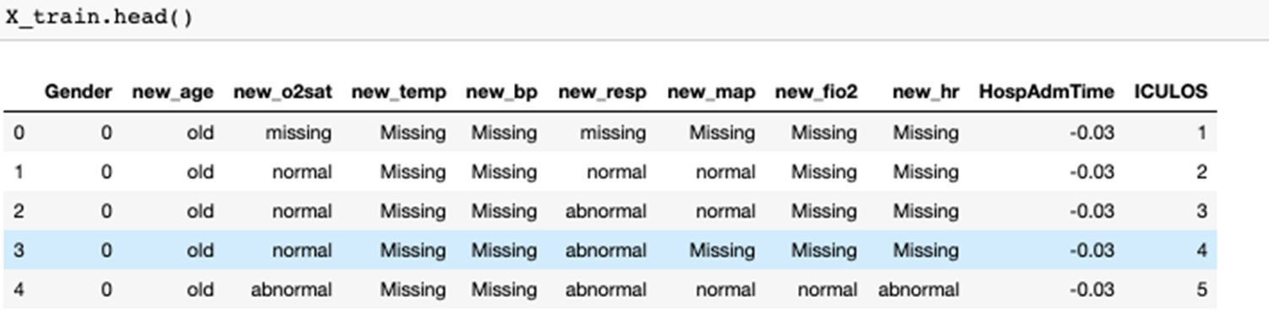
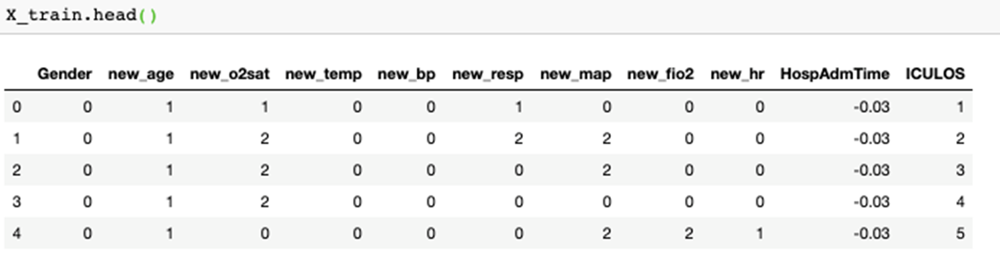
All these are categorically values. They are encoded so that it is easier to run a ML algorithm.

Slide 17
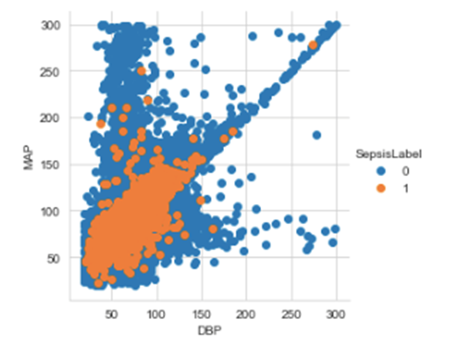
FEATURE SELECTION
Two Approaches employed for Feature Selection:
Checked correlation of features contributing to the presence of Sepsis
Read health magazines and Research journals such as
US National Library of Medicine, National Institutes of Health
Centers for Disease Control and Prevention
Sepsis - The American Journal of Medicine

Slide 18
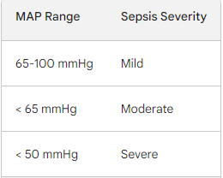
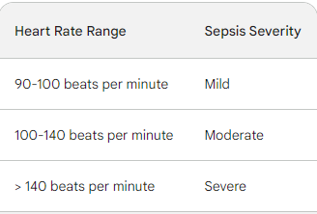
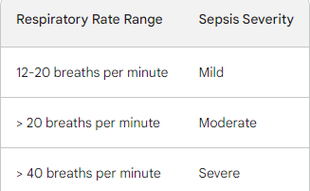
FEATURES SELECTED
Mean arterial pressure (MAP)
the average pressure in the arteries during one cardiac cycle.
Respiratory rate
the number of times a person's lungs expand and contract per minute
Heart rate
The number of times the heart beats per minute. It is measured by the pulse.

Slide 19
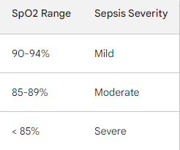
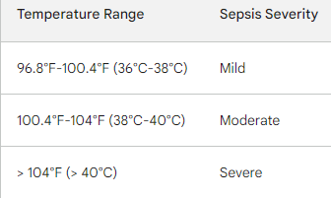
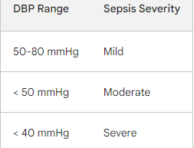
Oxygen saturation Pulse oximetry (%)
A non-invasive test that measures the amount of oxygen in the blood. It is done by placing a sensor on the fingertip or earlobe.
Temparature Sepsis can cause a high fever (above 100.4°F/38°C) or a low fever (below 96.8°F/36°C)
Diastolic blood pressure (DBP) the minimum pressure in the arteries when the heart is at rest.

Slide 20
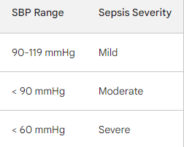
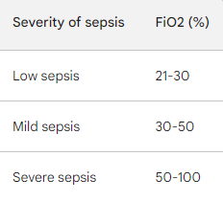
Systolic blood pressure (SBP) the pressure in the arteries when the heart beats
Fraction of inspired oxygen
FiO2 is the percentage of oxygen in the air that a person breathes, which can be increased in sepsis to improve oxygen delivery to the tissues.

Slide 21
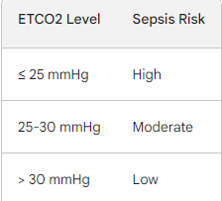
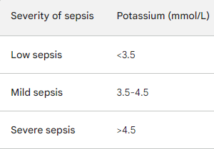
Potassium (mmol/L)
Potassium is an essential mineral that helps regulate muscle contraction, nerve conduction, and fluid balance in the human body.
EndTidal Carbon Di-oxide (mmHg)
measure of the carbon dioxide level in the exhaled breath. It is a non-invasive way to measure the carbon dioxide level in the blood.

Slide 22
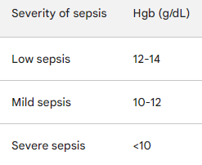
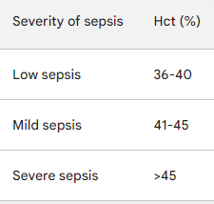
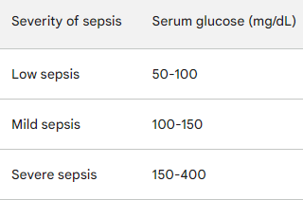
Glucose Serum (mg/dL)
Glucose is a sugar that is the body's main source of energy.
Hemoglobin (g/dL)
Hemoglobin is a protein in red blood cells that carries oxygen to the tissues. Low levels of Hgb can occur in sepsis, which can lead to tissue hypoxia and organ damage.
Hct Hematocrit (%)
Hct is the percentage of red blood cells in the blood. In sepsis, Hct levels can decrease due to fluid loss or hemolysis.

Slide 23
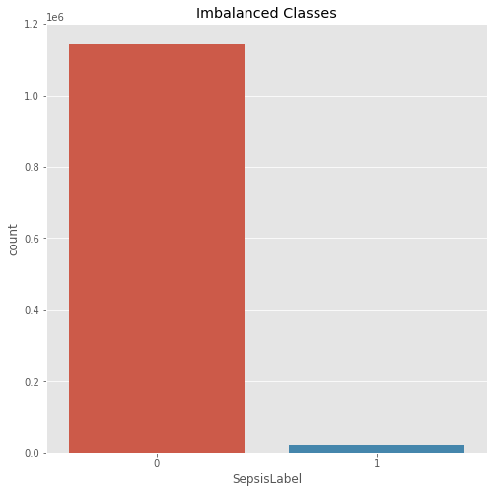
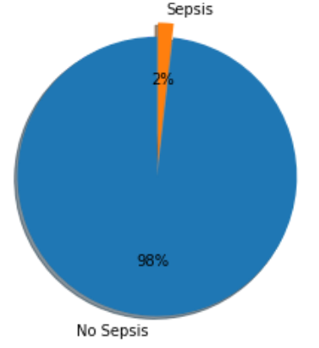
IMBALANCED DATA:
98% of patients does not have sepsis and 2% have sepsis.
Problem with Accuracy
Ways to deal with Imbalance:
Under sampling
Over sampling

Slide 24
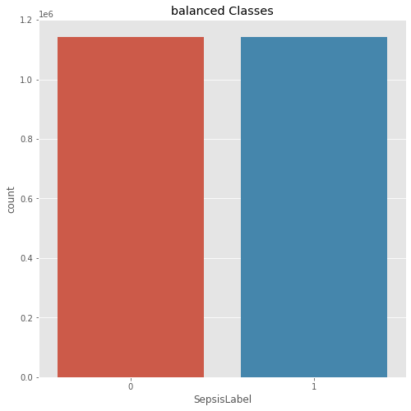
For sepsis patients, SepsisLabel is 1.
For non-sepsis patients, SepsisLabel is 0.
Balancing Data with Random-over sampler Technique

Slide 25

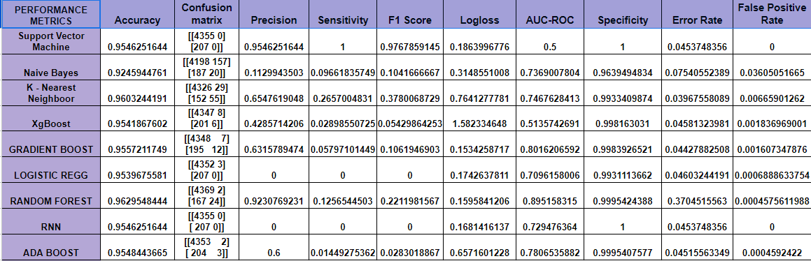
ALGORITHMS WE TRIED OUT ....

Slide 26
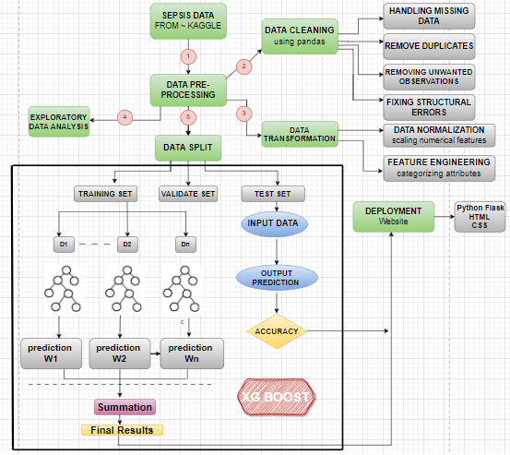
ARCHITECTURE

Slide 27
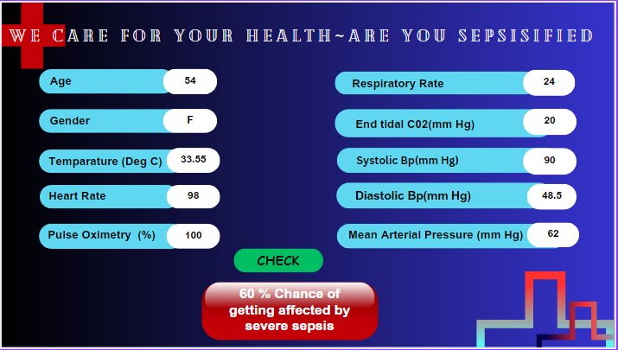
User Interface
© 2023 Cognizant
7

Slide 28

CONCLUSION
We have handled the missing ness and imbalance in the large dataset
We removed missing values > 92%
Performed feature engineering (8 new features) and selected important features
We aimed to predict the onset of the sepsis so far the Machine Learning model employed seem to classify it partially
The project has a scope of continuing with further research on the importance of the features, better model building and under the guidance of a good health science domain expert.

Slide 29
6 th July DEFINE THE PROBLEM Analyzing the problem and choose the best solution. | 7 th July DATA COLLECTION Gathering data regarding problem statement for the ML model | 9 th July PREPARING THE DATA Cleaning the data, remove null values and duplicate values. | 12 th July MODEL SELECTION Choosing an appropriate algorithm. | 14 th July TRAIN THE MODEL Feeding the data to model and making it learn. | 30 th July DEPLOYMENT First, accuracy measurement. Second, make model available to users.
6
5
4
3
2
1
ROADMAP

Slide 30
Date of connect | Time | Platform | Agenda of the meet
10-07-23 | 10:30 am - 11 am | Gmeet | Case Study & Problem statement
12-07-23 | 6:30 pm - 7:00 pm | Gmeet | Data set
13-07-23 | 1:00 pm - 1:30 pm | Mail and WhatsApp chat | Algorithm - XG Boost finalized
14-07-23 | 6:00 pm - 7:00 pm | Gmeet | Architecture
15-07-23 | 10:00 am - 11:00 am | Gmeet - CTS Mentors | Back end : Code and output analysis
19-07-2023 | 11:00 am - 12 : 30 pm | Gmeet - CTS Mentors | Data set - Data Preprocessing
27-07-2023
19-07-2023 | 11:00 am - 11 : 45 pm | Gmeet - CTS Mentors | User Interface
11:00 am - 11 : 45 pm
03-08-2023
11:00 am - 11 : 45 pm
Gmeet - CTS Mentors
Overall Evaluation
© 2023 Cognizant

Slide 31


Thank you
© 2023 Cognizant
Notes:
11

